Slide 1
Javascript Regular Expressions and canvas
IN712 Web 3

Slide 2
Javascript Regular Expressions
Regular expressions provide a means of defining a pattern of characters, which you can then use to split, search for, or replace characters in a string when they fit the defined pattern
Regular expressions in JavaScript are used through the RegExp object

Slide 3
Javascript Regular Expressions
You have two ways of creating a new RegExp object
var myRegExp = /\b'|'\b/;
var myRegExp = new RegExp("\\b'|'\\b");
The main reason for using the second method is that it allows the regular expression to be determined at run time
As the code is executing and not when you are writing the code
This is useful if, for example, if you want to base the regular expression on user input

Slide 4
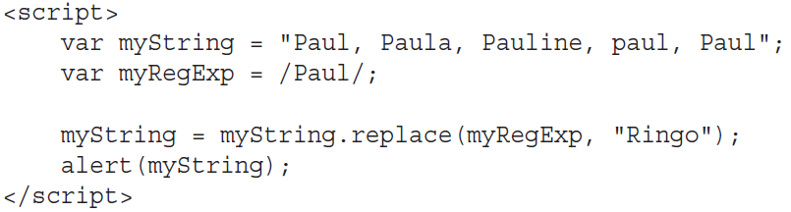
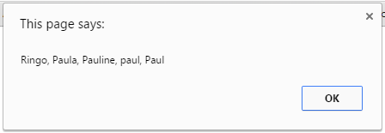
Regular expression example
By default, the RegExp object looks only for the first matching pattern, in this case the first Paul, and then
stops.

Slide 5
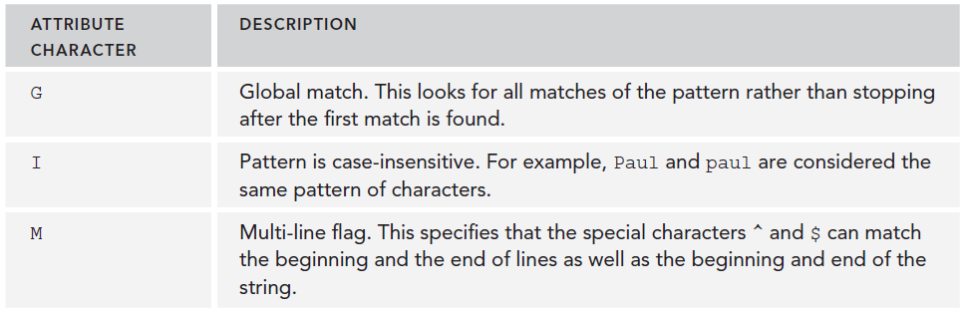
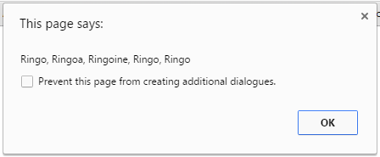

Attribute Characters

Slide 6
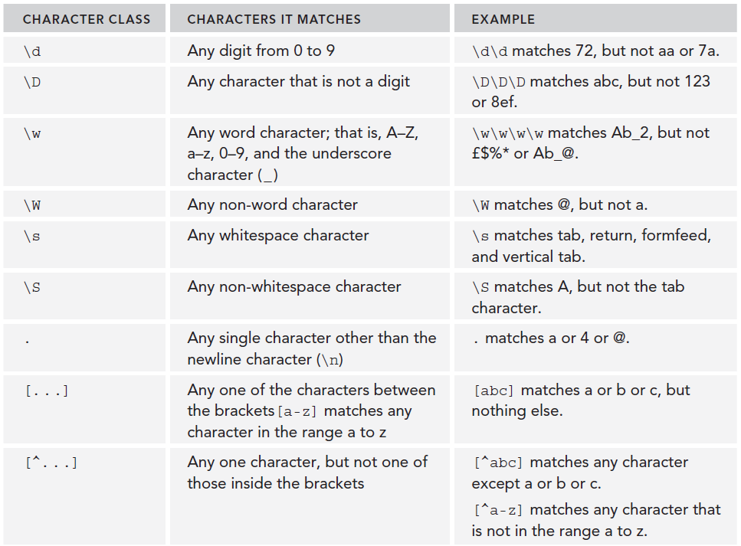
Regular expressions special characters

Slide 7
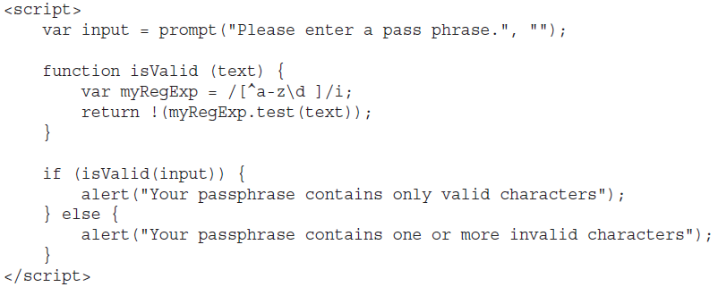
Example

Slide 8
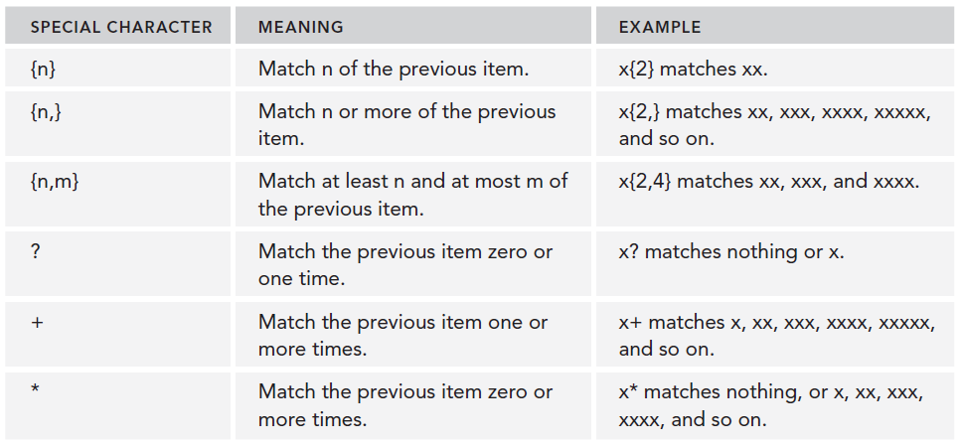
Repetition characters

Slide 9
Example: matching a telephone number
match a telephone number in the format 1‐800‐888‐5474
var myRegExp = /\d‐\d\d\d‐\d\d\d‐\d\d\d\d/
var myRegExp = /\d-\d{3}-\d{3}-\d{4}/

Slide 10
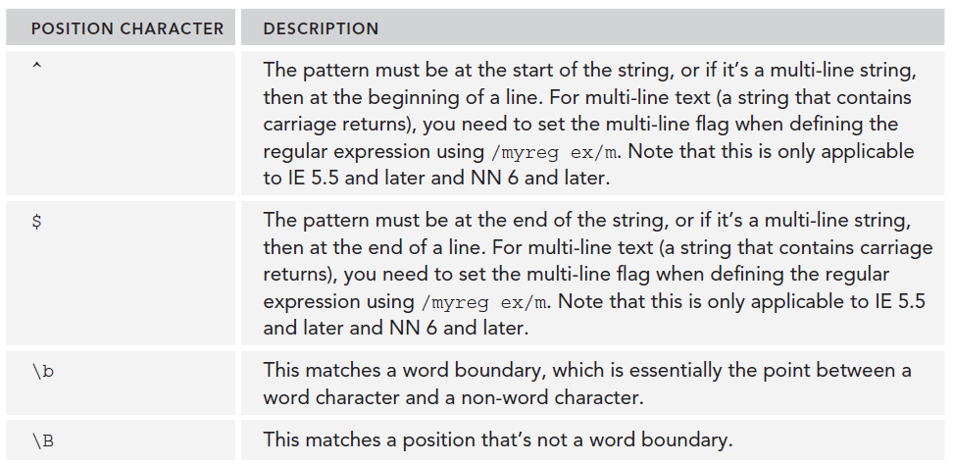

Position characters

Slide 11
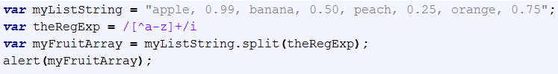
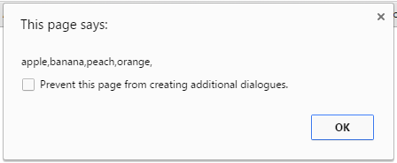
The String split() method
A String method that uses a regular expression or a fixed string to break a string into an array of substrings.

Slide 12
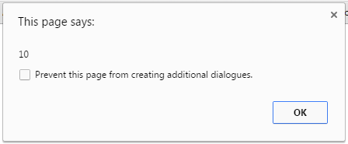
The String search() method
A String method that tests for a match in a string. It returns the index of the match, or -1 if the search fails.

Slide 13

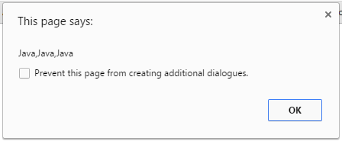
The String match() method
A String method that executes a search for a match in a string. It returns an array of matches or null on a mismatch.

Slide 14
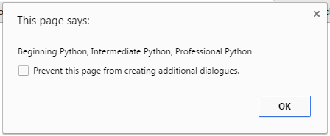
The String replace() method
A String method that executes a search for a match in a string, and replaces the matched substring with a replacement substring.

Slide 15

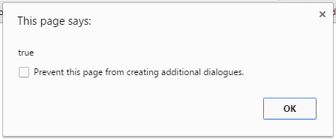
The RegExp test() method
A RegExp method that tests for a match in a string. It returns true or false.

Slide 16
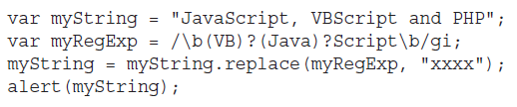
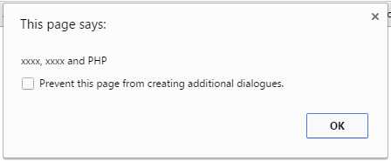
Grouping regular expressions
A word boundary: \b
Zero or one instance of VB: (VB)?
Zero or one instance of Java: (Java)?
The characters Script: Script
A word boundary: \b

Slide 17
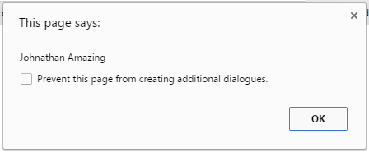
Reusing groups of characters
var re=/(\w+)\s(\w+)/;
var str="Amazing Jonathan";
var newstr = str.replace(re,"$1 $1");
alert(newstr);

Slide 18
A word on the mechanics of matching

Slide 19
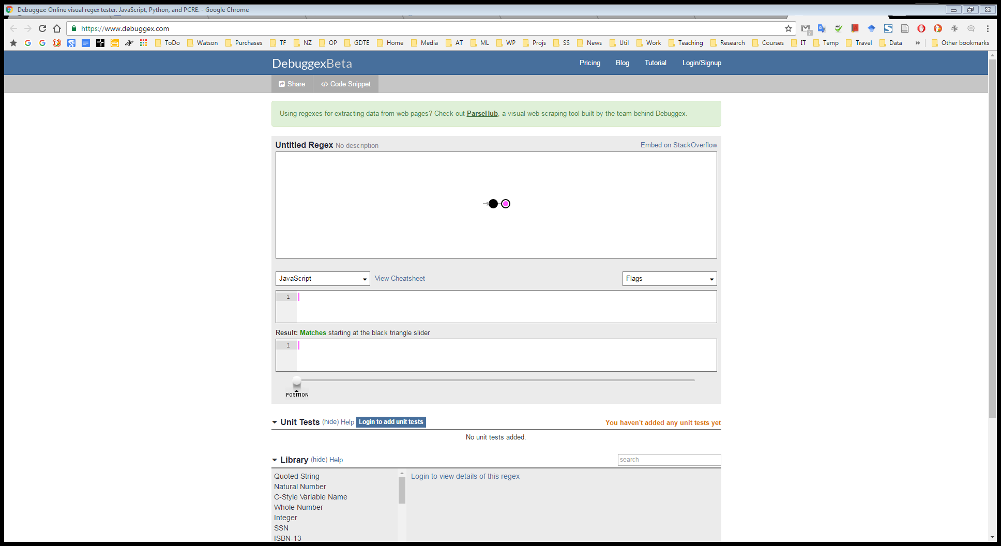
Debugging regular expressions

Slide 20
JavaScript and the HTML5 Canvas

Slide 21
Introduction
Browsers give us several ways to display graphics.
HTML/CSS: The simplest way is to use styles to position and color regular DOM elements. This can get you quite far. But some tasks, such as drawing a line between arbitrary points, are extremely awkward to do with regular HTML elements.
DOM-based but utilizes Scalable Vector Graphics (SVG): Think of SVG as an HTML dialect for describing documents that focuses on shapes rather than text. You can embed an SVG document in an HTML document, or you can include it through an <img> tag.
The canvas: a single DOM element that encapsulates a picture. It provides a programming interface for drawing shapes onto the space taken up by the node.
Notes:
The main difference between a canvas and an SVG picture is that in SVG the original description of the shapes is preserved so that they can be moved or resized at any time. A canvas, on the other hand, converts the shapes to pixels (colored dots on a raster) as soon as they are drawn and does not remember what these pixels represent. The only way to move a shape on a canvas is to clear the canvas (or the part of the canvas around the shape) and redraw it with the shape in a new position.

Slide 22
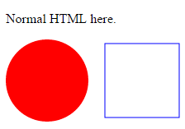
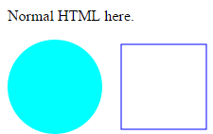
SVG
<!DOCTYPE html>
<html lang="en">
<head>
<title>SVG</title>
</head>
<body>
<p>Normal HTML here.</p>
<svg xmlns="http://www.w3.org/2000/svg">
<circle r="50" cx="50" cy="50" fill="red"/>
<rect x="120" y="5" width="90" height="90"
stroke="blue" fill="none"/>
</svg>
</body>
</html>
An HTML document with a simple SVG picture in it
The xmlns attribute changes an element (and its children) to a different XML namespace.
This namespace, identified by a URL, specifies the dialect that we are currently speaking.
The <circle> and <rect> tags, which do not exist in HTML, do have a meaning in SVG—they draw shapes using the style and position specified by their attributes.
These tags create DOM elements, just like HTML tags.
<script>
var circle = document.querySelector("circle");
circle.setAttribute("fill", "cyan");
</script>

Slide 23
HTML, SVG or canvas
There is no single best approach that works in all situations. Each option has strengths and weaknesses.
Plain HTML has the advantage of being simple. It also integrates well with text.
SVG can be used to produce crisp graphics that look good at any zoom level. It is more difficult to use than plain HTML but also much more powerful.
Both SVG and HTML build up a data structure (the DOM) that represents the picture. This makes it possible to modify elements after they are drawn. If you need to repeatedly change a small part of a big picture in response to what the user is doing or as part of an animation, doing it in a canvas can be needlessly expensive. The DOM also allows us to register mouse event handlers on every element in the picture (even on shapes drawn with SVG). You can’t do that with canvas.
But canvas’s pixel-oriented approach can be an advantage when drawing a huge amount of tiny elements. The fact that it does not build up a data structure but only repeatedly draws onto the same pixel surface gives canvas a lower cost per shape.
There are also effects, such as rendering a scene one pixel at a time (for example, using a ray tracer) or postprocessing an image with JavaScript (blurring or distorting it), that can only be realistically handled by a pixel-based technique.

Slide 24
The Canvas element
HTML5 graphical power is often mentioned in web development circles
Games can be written that run in the browser
Actually this power doesn’t come from HTML5, except in the sense that the new standard introduces an element that works as a drawing surface
All the actual awesomeness is accomplished by JavaScript talking to the canvas element
There is too much for us to do everything, so we will look only at the core; if you’re interested in doing serious art work in the browser, an appropriate reference text is essential
Flash was the way of creating graphical web applications in the past but recently it has been made obsolete by HTML5

Slide 25
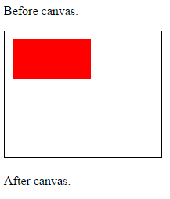
The canvas element
Canvas graphics can be drawn onto a <canvas> element. You can give such an element width and height attributes to determine its size in pixels
A new canvas is empty, it is entirely transparent and thus shows up simply as empty space in the document
The <canvas> tag is intended to support different styles of drawing. To get access to an actual drawing interface, we first need to create a context, which is an object whose methods provide the drawing interface.
There are currently two widely supported drawing styles: "2d" for two-dimensional graphics and "webgl" for three-dimensional graphics through the OpenGL interface.
When no width or height attribute is specified, as in the previous example, a canvas element gets a default width of 300 pixels and height of 150 pixels.
<!DOCTYPE html>
<html>
<head>
<title>JavaScript Canvas</title>
</head>
<body>
<p>Before canvas</p>
<canvas style="border: solid 1px black" width="200" height="160">
</canvas>
<p>After canvas.</p>
<script>
var canvas = document.querySelector("canvas");
var context = canvas.getContext("2d");
context.fillStyle = "red";
context.fillRect(10, 10, 100, 50);
</script>
</body>
</html>

Slide 26
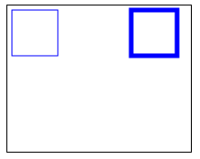
Filling and stroking
In the canvas interface, a shape can be filled, meaning its area is given a certain color or pattern, or it can be stroked, which means a line is drawn along its edge.
The color of the fill, thickness of the stroke, and so on are not determined by an argument to the method (as you might justly expect) but rather by properties of the context object.
<script>
var cx = document.querySelector("canvas").getContext("2d");
cx.strokeStyle = "blue";
cx.strokeRect(5, 5, 50, 50);
cx.lineWidth = 5;
cx.strokeRect(135, 5, 50, 50);
</script>

Slide 27
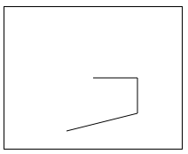
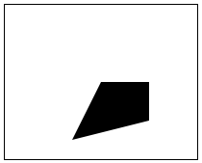
Paths
A path is a sequence of lines.
When filling a path (using the fill method), if the path is not already closed, a line is added from its end to its start, and the shape enclosed by the completed path is filled.
var cx = document.querySelector("canvas").getContext("2d");
cx.beginPath();
cx.moveTo(100, 80);
cx.lineTo(150, 80);
cx.lineTo(150, 120);
cx.lineTo(70, 140);
cx.stroke();
var cx = document.querySelector("canvas").getContext("2d");
cx.beginPath();
cx.moveTo(100, 80);
cx.lineTo(150, 80);
cx.lineTo(150, 120);
cx.lineTo(70, 140);
cx.fill();

Slide 28
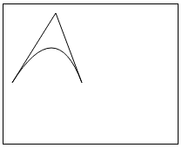
Curves
A path may also contain curved lines.
The quadraticCurveTo method draws a curve to a given point. To determine the curvature of the line, the method is given a control point as well as a destination point. Imagine this control point as attracting the line, giving the line its curve.
<script>
var cx = document.querySelector("canvas").getContext("2d");
cx.beginPath();
cx.moveTo(10, 90);
// control=(60,10) goal=(90,90)
cx.quadraticCurveTo(60, 10, 90, 90);
cx.lineTo(60, 10);
cx.closePath();
cx.stroke();
</script>

Slide 29
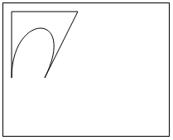
Curves
The bezierCurveTo method draws a similar kind of curve. Instead of a single control point, this one has two—one for each of the line's endpoints.
<script>
var cx = document.querySelector("canvas").getContext("2d");
cx.beginPath();
cx.moveTo(10, 90);
// control1=(10,10) control2=(90,10) goal=(50,90)
cx.bezierCurveTo(10, 10, 90, 10, 50, 90);
cx.lineTo(90, 10);
cx.lineTo(10, 10);
cx.closePath();
cx.stroke();
</script>

Slide 30
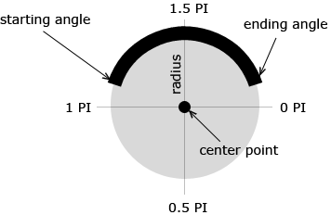
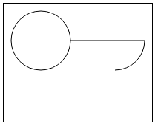
Arcs
Arcs are fragments of a circle
context.arc(x, y, radius, startAngle, endAngle, antiClockwise)
<script>
var cx = document.querySelector("canvas").getContext("2d");
cx.beginPath();
// center=(50,50) radius=40 angle=0 to 7
cx.arc(50, 50, 40, 0, 7);
// center=(150,50) radius=40 angle=0 to ½π
cx.arc(150, 50, 40, 0, 0.5 * Math.PI);
cx.stroke();
</script>

Slide 31
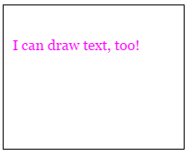
Text
A 2D canvas drawing context provides the methods fillText and strokeText
You can specify the size, style, and font of the text with the font property
You can add italic or bold to the start of the string to select a style
<script>
var cx = document.querySelector("canvas").getContext("2d");
cx.font = "16px Georgia";
cx.fillStyle = "fuchsia";
cx.fillText("I can draw text, too!", 10, 50);
</script>

Slide 32
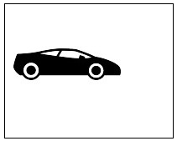
Images
In computer graphics, a distinction is often made between vector graphics and bitmap graphics. The first is what we have been doing so far in this chapter—specifying a picture by giving a mathematical description of shapes. Bitmap graphics, on the other hand, don’t specify actual shapes but rather work with pixel data (rasters of colored dots).
The drawImage method allows us to draw pixel data onto a canvas. This pixel data can originate from an <img> element or from another canvas, and neither has to be visible in the actual document.
<script>
var cx = document.querySelector("canvas").getContext("2d");
var img = document.createElement("img");
img.src = "car.png";
img.addEventListener("load", function() {
cx.drawImage(img, 10, 50);
});
</script>

Slide 33
Images
By default, drawImage will draw the image at its original size. You can also give it two additional arguments to dictate a different width and height.
When drawImage is given nine arguments, it can be used to draw only a fragment of an image. The second through fifth arguments indicate the rectangle (x, y, width, and height) in the source image that should be copied, and the sixth to ninth arguments give the rectangle (on the canvas) into which it should be copied.
This can be used to pack multiple sprites (image elements) into a single image file and then draw only the part you need.
To animate the picture on a canvas, the clearRect method is useful. It resembles fillRect, but instead of coloring the rectangle, it makes it transparent, removing the previously drawn pixels.
We know that each sprite, each subpicture, is 24 pixels wide and 30 pixels high.
Check spritesDemo.html

Slide 34
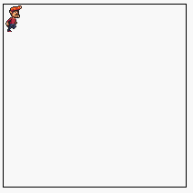
sprites.png
spritesDemo.html
<!DOCTYPE html>
<html>
<head>
<title>JavaScript Canvas</title>
</head>
<body>
<canvas style="border: solid 1px black" width="200" height="200"></canvas>
<script>
var cx = document.querySelector("canvas").getContext("2d");
var img = document.createElement("img");
img.src = "sprites.png";
var spriteW = 24, spriteH = 30;
img.addEventListener("load", function() {
var cycle = 0;
setInterval(function() {
cx.clearRect(0, 0, spriteW, spriteH);
cx.drawImage(img,
// source rectangle
cycle * spriteW, 0, spriteW, spriteH,
// destination rectangle
0, 0, spriteW, spriteH);
cycle = (cycle + 1) % 8;
}, 120);
});
</script>
</body>
</html>

Slide 35
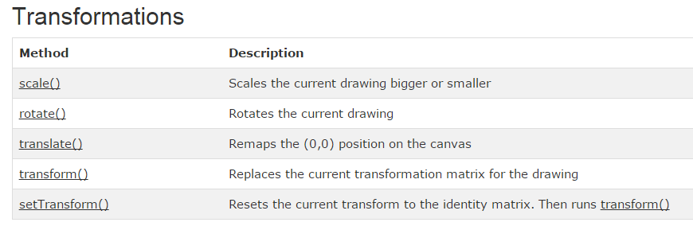
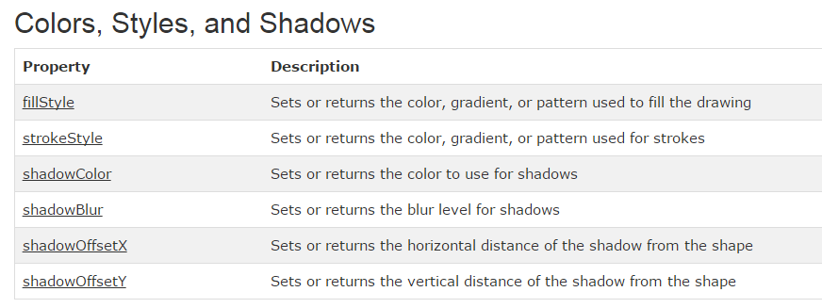

Slide 36
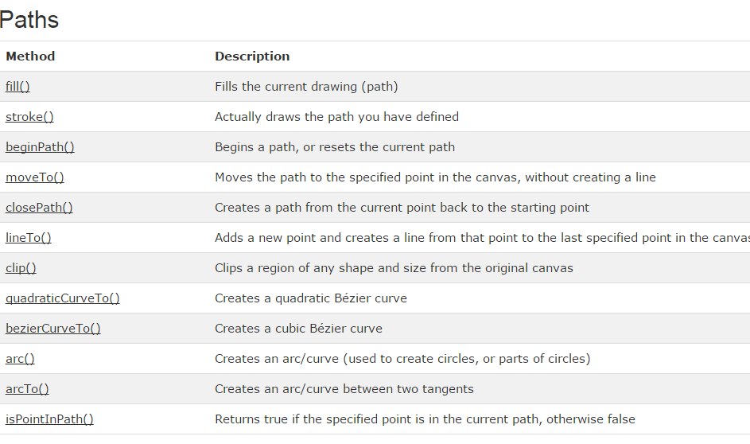

Slide 37
Timers in a Web Page

Slide 38
Stopping a Timer

Slide 39
Animation Clock
Drawing is good; animation is better.
To achieve the clock cycle required for animation (serial frequent presentation of images) in Javascript we use the setInterval method.
This is a method of the global object (it is fine to think of it as a method of the page, or the application), so you can call it from pretty much anywhere.
setInterval(function object, interval)
setInterval returns an identifier
To stop looping, pass the id to clearInterval(id)

Slide 40
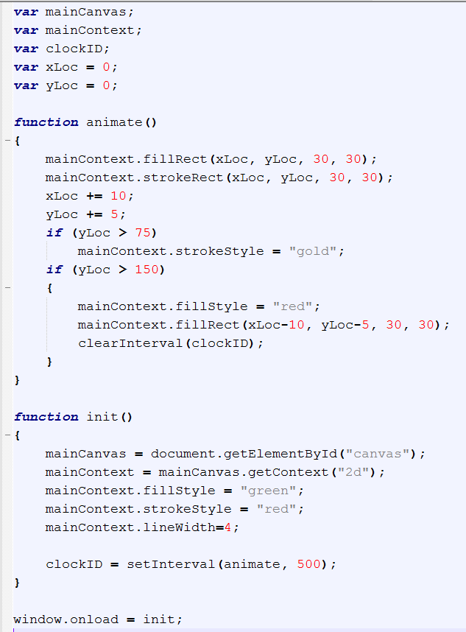
What will this code do?

Slide 41
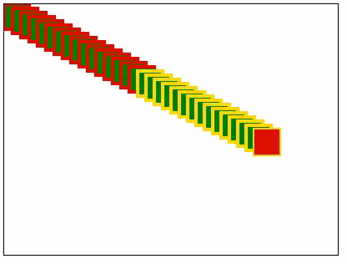
Output

Slide 42
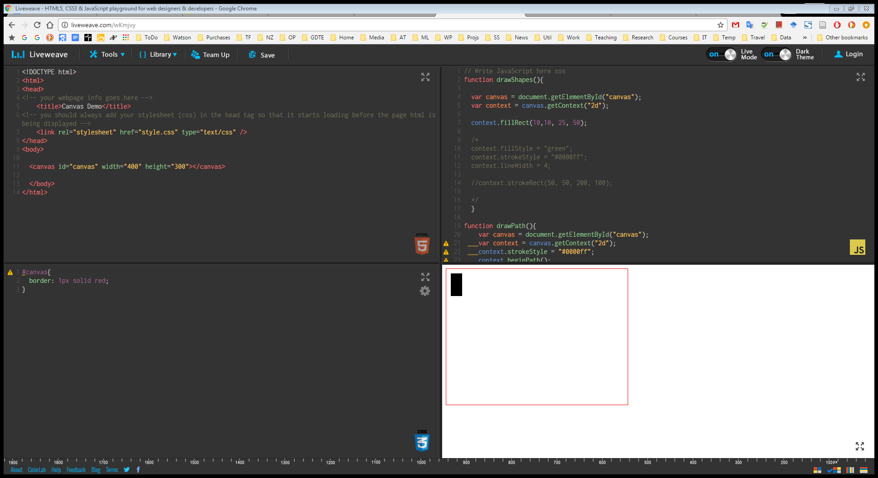
Demo

Slide 43
Appendix - JavaScript strict mode
A program is crystallized thought.
Sometimes those thoughts are confused.
Other times, mistakes are introduced when converting thought into code.
Either way, the result is a flawed program.
The degree to which languages help you find such mistakes varies.
JavaScript is at the “hardly helps at all” end of that scale.
Some languages want to know the types of all your variables and expressions before even running a program and will tell you right away when a type is used in an inconsistent way.
JavaScript considers types only when actually running the program, and even then, it allows you to do some clearly nonsensical things without complaint, such as x = true * monkey".

Slide 44
Appendix - JavaScript strict mode
JavaScript can be made a little more strict by enabling strict mode.
This is done by putting the string "use strict" at the top of a file or a function
Normally, when you forget to put var in front of your variable, as with counter in the example, JavaScript quietly creates a global variable and uses that.
In strict mode, however, an error is reported instead.

Slide 45
References
Beginning JavaScript (5th Edition)
Eloquent JavaScript

